Slide 1

Machine Learning Consumer Loan Processing
DRAFT
Ram Rao
July 1, 2022
DSA 5900 Practicum

Slide 2

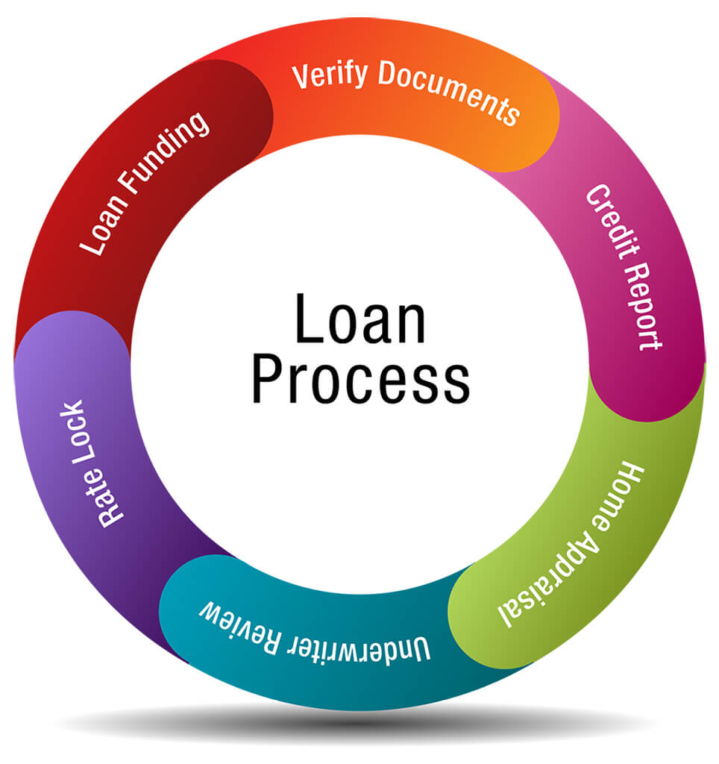
Project Definition
Identify Credit-Worthiness of Loan Applicants at Financial Institutions
Apply Machine Learning Models to Evaluate whether Applicants will default on a Loan
Identify a Process for Remote Machine Learning
Stakeholders:
Agencies that Process Consumer Loans
Dr. Radhakrishnan and Dr. Trafalis are my advisors

Slide 3

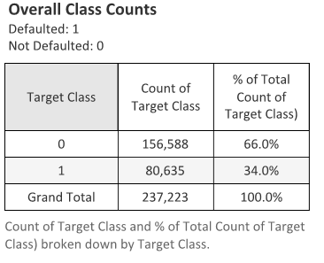


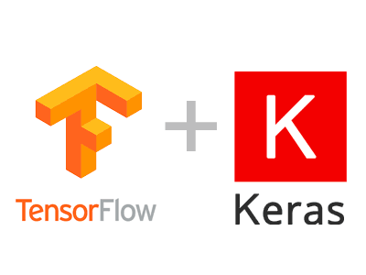

Data Ingestion
Data Source:
https://www.bondora.com/en/public-reports
Tableau, Python, Sckit Learn, Tensorflow/Keras,
PyTorch and PySft
No of Features
111 Predictor Variables
1 Target Variable
Defaulted : 1
Non Defaulted : 0
Tableau : Data Viz
Python: Data Processing
Sckit Learn: ML Models
Tensorflow/Keras: Neural Net
PyTorch, PySft: Remote ML

Slide 4

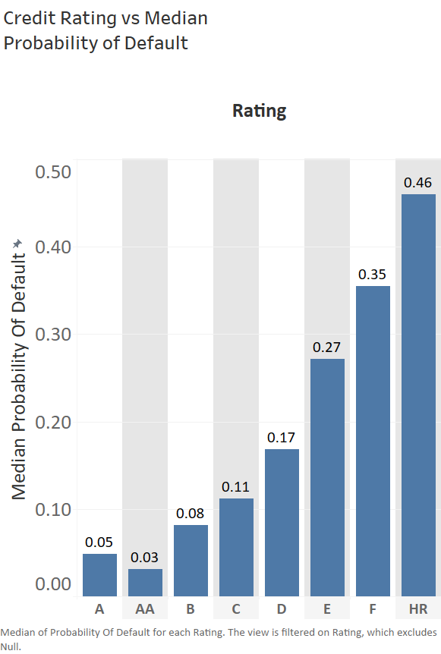
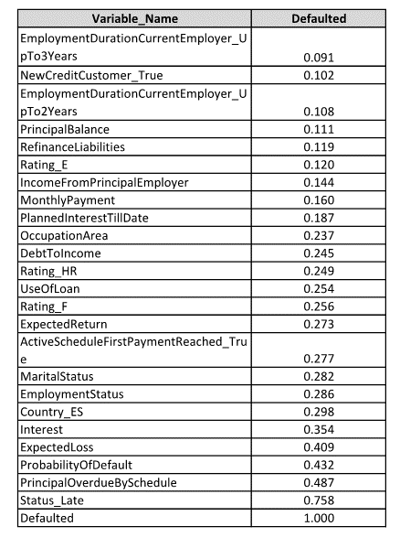
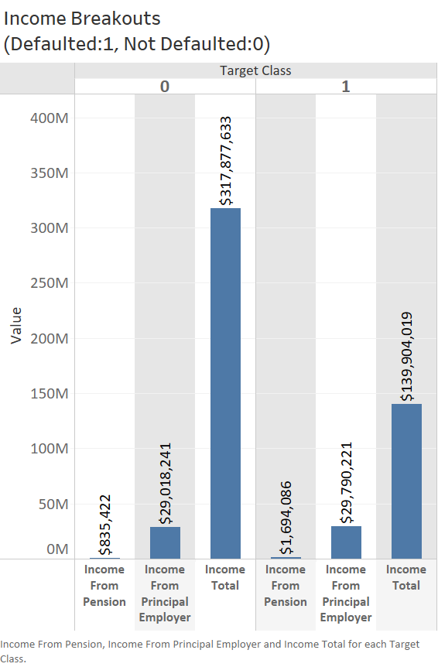
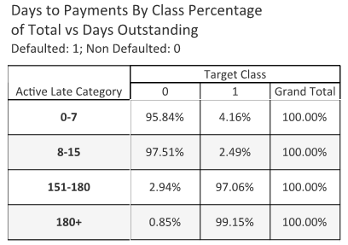
Data Exploration and Preparation - 1
Correlation Coefficient
Exploratory Analysis:
Lower Default
Higher Income
Lower Interest Servicing
Better Credit Rating
Higher Previous Credit
Higher Education
More Prompt Payment
No Significant Multicollinearity
Correlation Not High Between Predictor and Target

Slide 5
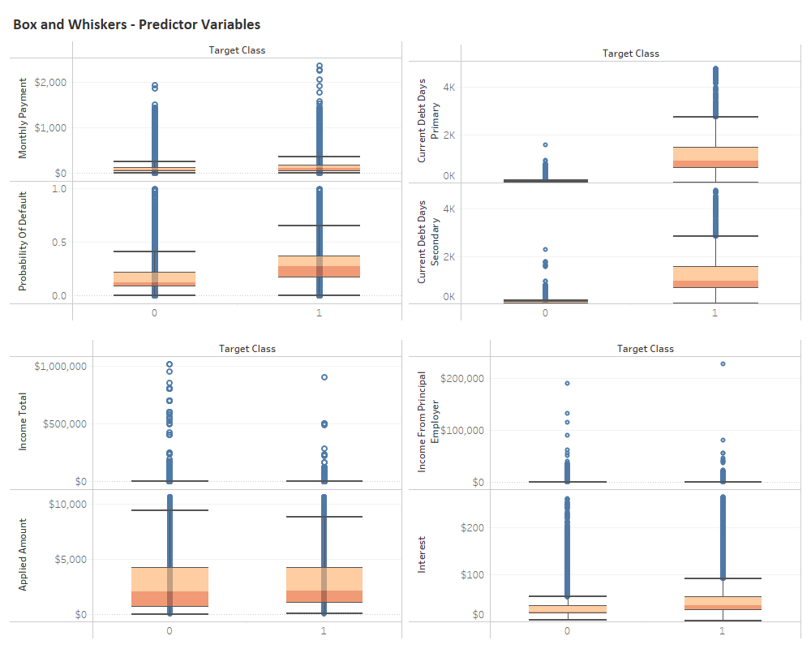
Data Exploration and Preparation - 2
Exploratory Analysis:
Higher Spread and Max for Target Class 1
Probability of Default
Debt Types
Interest Servicing
No Significant Differences Between Classes
Applied Amount
Income Types
Missing Values Eliminated Preliminarily

Slide 6
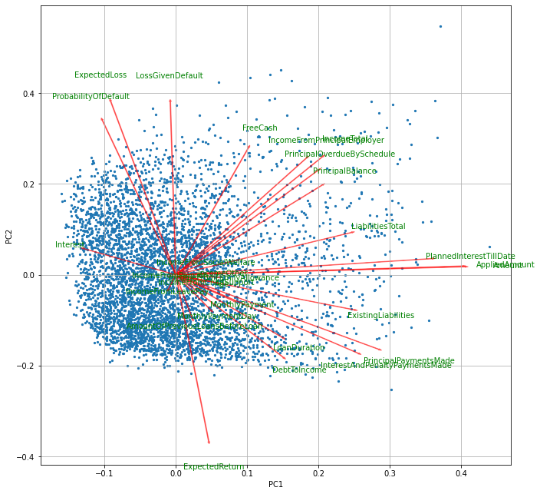
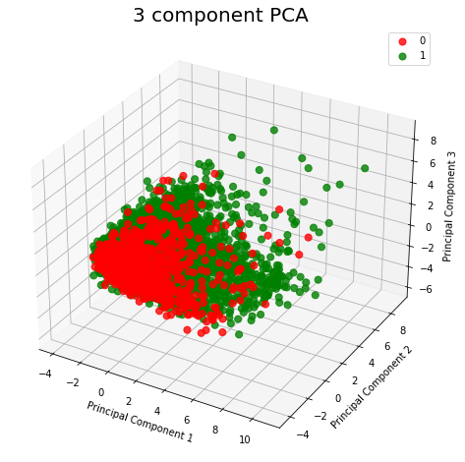
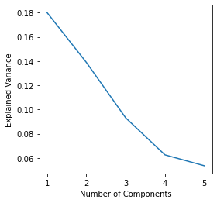
PCA Assessment
PCA Analysis:
5,000 Dataset Points Analyzed
No of Continuous Variables Scaled and Transformed: 28
Limited Variance Explained by 5 Components
No Significant Separation Between Classes Observed from PCA 1, 2, and 3
Bi Plot shows Explanation of Few Features from PCA 1 and 2
PCA Not a Significant Benefit to Model Predictability, Categorical Count Outweighs Continuous Variables

Slide 7
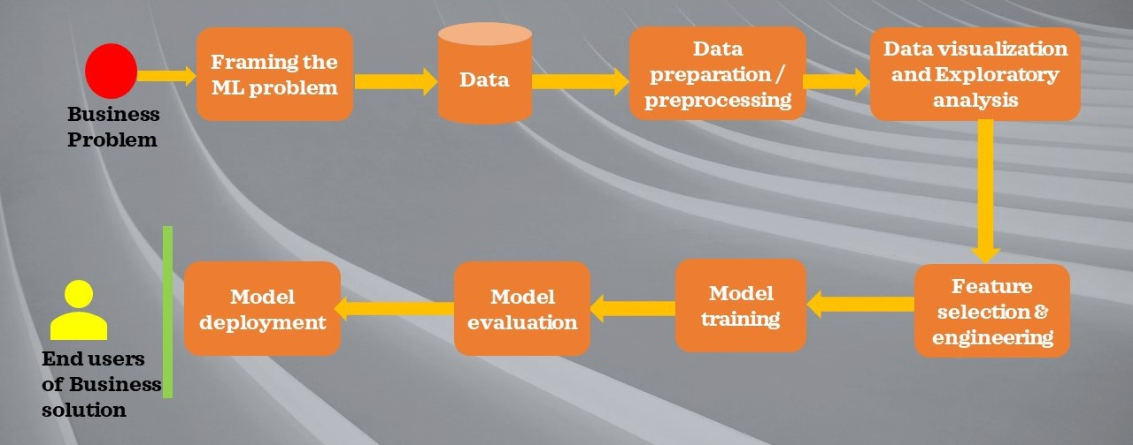
Modeling Preprocessing And Overview
Preprocessing with Sckit-Learn
Scaled Continuous Variables
One hot encoded Categorical Variables
Modeling, Training/Testing
Sckit Learn
Tensorflow Keras
Default
GridSearch CV Optimization
Remote Machine Learning – PyTorch and PySft
Sckit-Learn Metrics for Evaluation

Slide 8
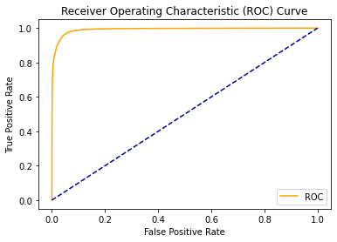
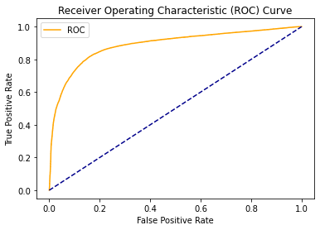
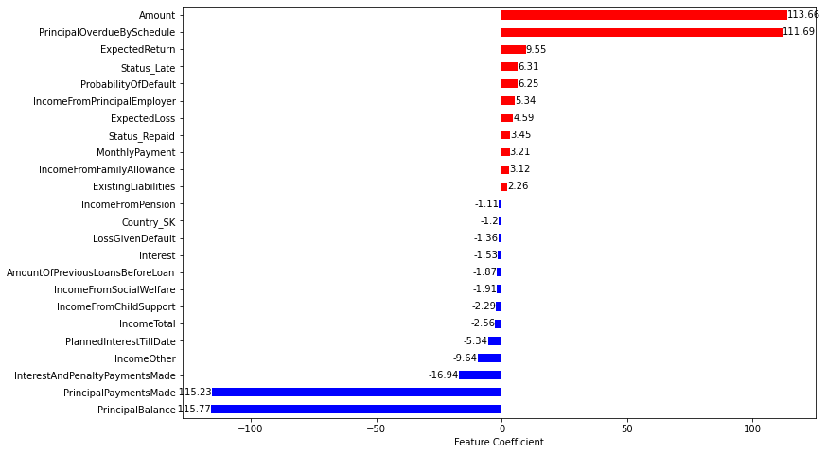
Model Results - Logistic Regression and Naïve Bayes
Model Results - Logistic Regression and Naïve Bayes
Logistic Regression:
Grid Search 5-Fold CV
200 Iterations
Hyperparameters
Penalty: L1 and L2
C : 1, 5, 10
Solver, lbfgs, liblinear and saga
Naïve Bayes:
Grid Search 5-Fold CV
Hyperparameters
Alpha: 1E-4, 1E-2, 1E-1, and 1
AUC = 0.951
AUC = 0.818
Logistic Regression
Naïve Bayes
Logistic Regression | Class 0 Predicted | Class 1 Predicted
Class 0 Actual | 26,280 | 907
Class 1 Actual | 928 | 13,687
Naïve Bayes | Class 0 Predicted | Class 1 Predicted
Class 0 Actual | 24,283 | 2,904
Class 1 Actual | 3,762 | 10,853
Logistic Regression

Slide 9
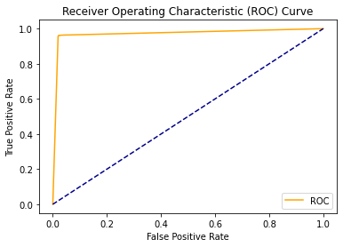

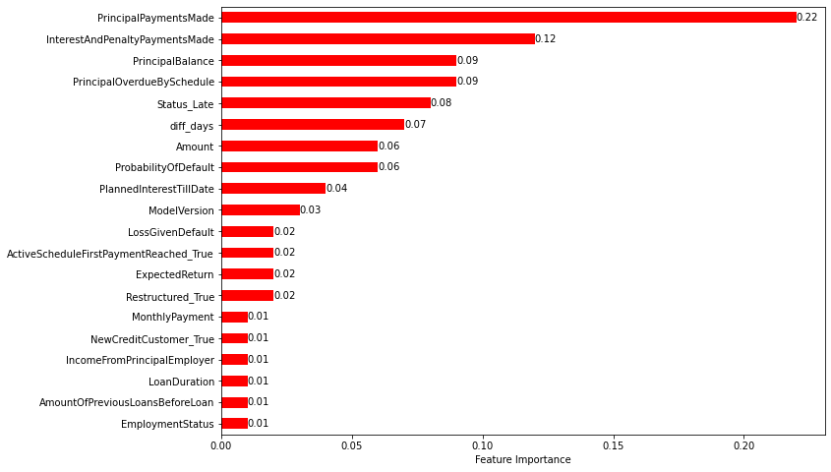
Model Results - Decision Trees and Ensemble Forests
Decision Trees:
Grid Search 5-Fold CV
Hyperparameters
Criterion : gini, entropy
Max_depth : 5,10,20
Ensemble Forests:
Grid Search 5-Fold CV
Hyperparameters
N_estimators: 5,10,20, 50, 100
Learning_Rate: 0.1, 0.5, 1. 0, 2.0, 5.0
AUC = 0.970
AUC = 0.939
Decision Trees
Ensemble Forests
Decision Trees | Class 0 Predicted | Class 1 Predicted
Class 0 Actual | 26,663 | 554
Class 1 Actual | 591 | 14,024
Ensemble Forests | Class 0 Predicted | Class 1 Predicted
Class 0 Actual | 26,238 | 949
Class 1 Actual | 1,276 | 13,339
Ensemble Forests

Slide 10
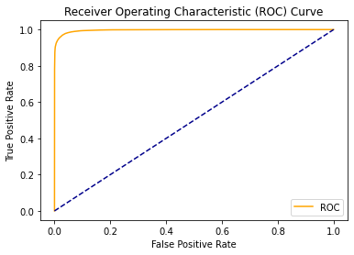

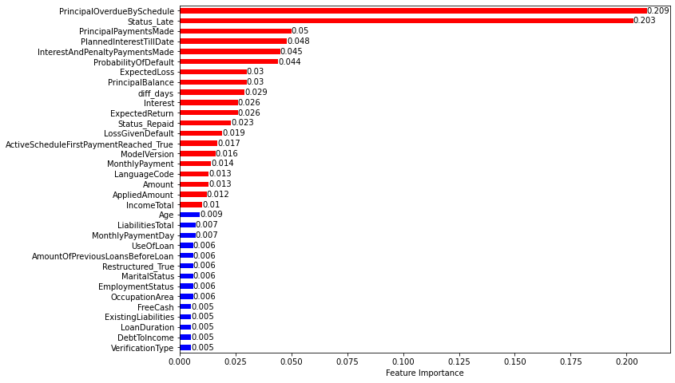
Model Results Random Forests
Random Forests:
Grid Search 5-Fold CV
Hyperparameters
N_estimators: 50, 100,200
Criterion: gini, entropy
Max_features: sqrt, log2, auto
AUC = 0.966
AUC = 0.964
Random Forests w/Tuning
Random Forests w/o Tuning
Random Forests | Class 0 Predicted | Class 1 Predicted
Class 0 Actual | 26,854 | 333
Class 1 Actual | 826 | 13,789
Random Forests w/Tuning

Slide 11
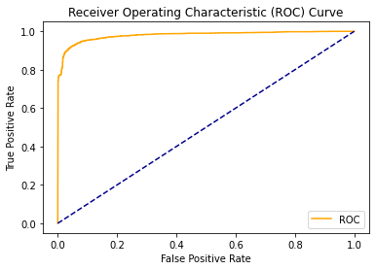
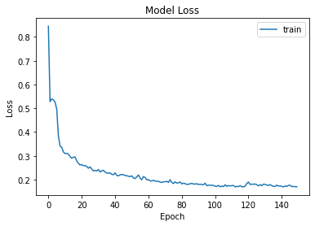
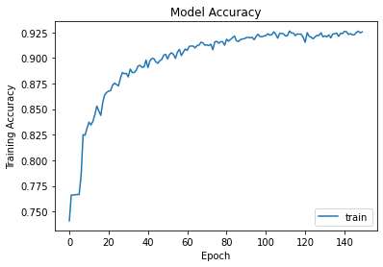
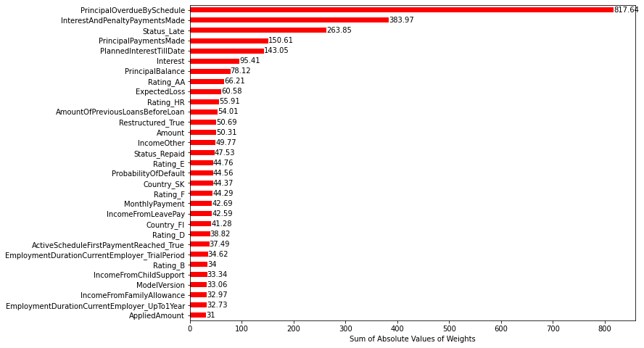
Model Results - Neural Nets, Keras/Tensorflow
Neural Net:
3 Hidden Layers: 100, 50, and 25 Neurons, Relu Activation
1 Output Layer, 1 Neuron, Sigmoid Activation
Grid Search CV = 3
Hyperparameters
Optimizer: rmsprop, adam
inits: glorot_uniform, normal, uniform
Epochs: 50,100
Batches: 5,20
Training Errors
Training Accuracy
AUC = 0.980
Neural Network
Neural Net | Class 0 Predicted | Class 1 Predicted
Class 0 Actual | 630 | 308
Class 1 Actual | 44 | 3,018
Neural Network with Tuning

Slide 12


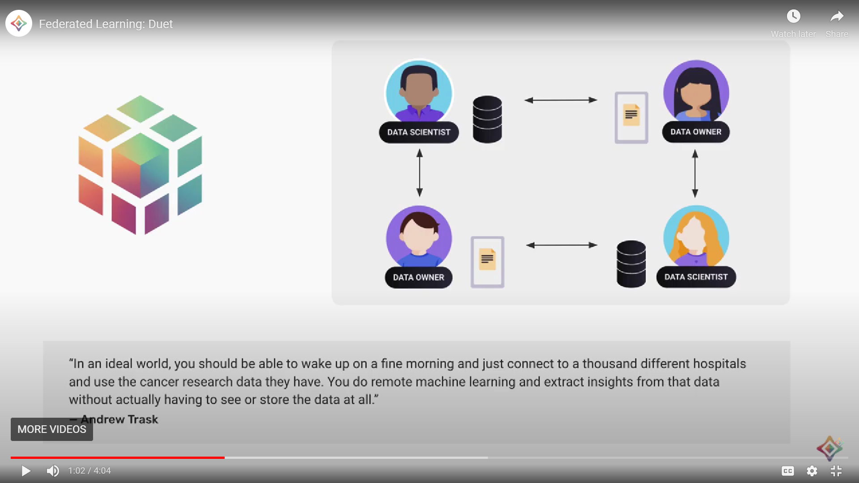
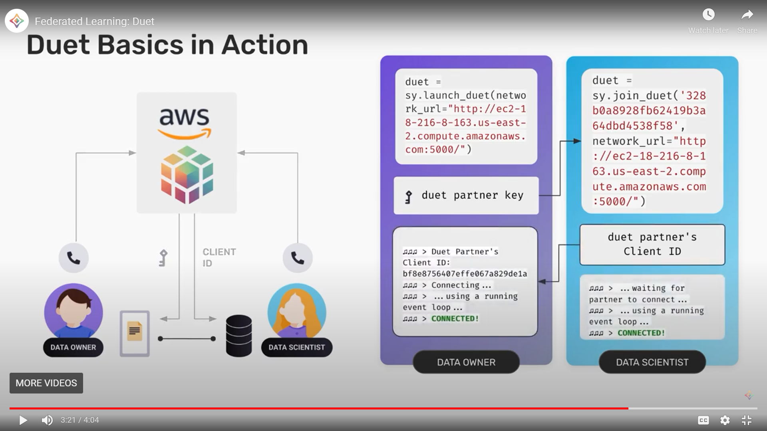
Remote Machine Learning - Overview
Why Useful?
Keeps Data Private
Data Owner has Control Over Data
Machine Learner Benefits from Access to Distributed Data
Process?
PySft Wrapper to ML Package
Encryption and Privacy Maintained
Machine Learner Can Access Multiple Data Sources Simultaneously
Models Trained Remotely and can be Aggregated for Use

Slide 13
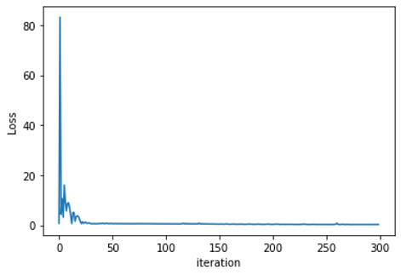
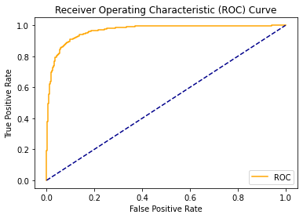
Remote Machine Learning –PyTorch/PySft Results
Remote Learning Process:
Data Owner/Data Scientist interact via PySyft and PyGrid/AWS
Data Owner sends data to Data Scientist
Data Scientist makes requests via Pysft to Data Owner
Data Scientist creates model
Data Scientist sends model to Owner
Training on Remote Server
Model Sent to Data Scientist Once Trained
Data Scientist Tests Model – Sckit Learn Packages
PyTorch and PySft:
2 Hidden Layers: 100 and 100 Neurons, Relu Activation
1 Output Layer, 2 Neurons, Log_soft_max Activation
300 Epochs
Optimizer: Adam
learning_rate = .01
nn.functional.nll_loss
Training Errors
PyTorch/ PySft | Class 0 Predicted | Class 1 Predicted
Class 0 Actual | 1,262 | 99
Class 1 Actual | 95 | 634
AUC = 0.966

Slide 14
Model Evaluation – Performance Metrics
 | Hyperparameters | RMSE | Accuracy | Precision | Recall | F_1Score | AUC
Logistic Regression | L1 Penalty, liblinear Solver, C =5 | 0.209 | 0.956 | 0.938 | 0.936 | 0.937 | 0.951
Naïve Bayes | Alpha = 1.0 | 0.399 | 0.841 | 0.789 | 0.743 | 0.765 | 0.818
Decision Tree | Criterion – entropy, Max_depth = 20 | 0.166 | 0.973 | 0.962 | 0.960 | 0.961 | 0.970
Ensemble Forest | N_estimators= 100 l_rate = 1.0 | 0.231 | 0.947 | 0.934 | 0.913 | 0.923 | 0.939
Random Forest | N_estimators = 200, Criterion – entropy, Max_ features = auto | 0.166 | 0.972 | 0.976 | 0.943 | 0.960 | 0.966
Neural Net – Keras/Tensorflow | Batch_size = 5, epochs=150, init- glorot_uniform, optimizer= adam | 0.249 | 0.912 | 0.907 | 0.986 | 0.945 | 0.980
Neural Net - PyTorch | To be Developed |  | 0.907 | 0.865 | 0.869 | 0.867 | 0.966
CONCLUSIONS - FORTHCOMING

Slide 15
Next Steps, To be Developed
What is the significance of your project?
How are the stakeholders affected by the outcome of your project?
What are your recommendations for improvements for researchers who may continue your work?
How will you build on this project in your work or academic career (optional)?

Slide 16

Questions

